Slide 1
Quiz app
Designed by: Aishee Bhattacharya & Anubhav Mishra
Department of Computer Science & engineering
Second year
section b

Slide 2
Introduction
This Quiz App is helpful for practicing Trivia Questions to increase cognitive skills along with knowledge gain.
Every time a user chooses to play, he/she has to answer three random trivia questions.
During the quiz, a Progress Bar tracks the user's progress through the questions. Also the current Question Number and Score is displayed at the top.
Correctness of the chosen answer is immediately displayed.
On completion of the quiz, the score is displayed along with options to Save the score with the user name, Play the quiz again & to go back to the Home page.
On the Home page, by clicking on the High Scores button, the scores saved in Local Storage is displayed.

Slide 3
Website features
Built using HTML, CSS & JavaScript
HTML is dynamically generated in JavaScript
Trivia questions are fetched from Open Trivia DB API
High scores are saved in Local Storage
CSS has been used to animate backgrounds and style up the Website
JavaScript & ES6 JavaScript has used to add interactive features and to fetch API

Slide 4

Website Glimpses
Home Page

Slide 5
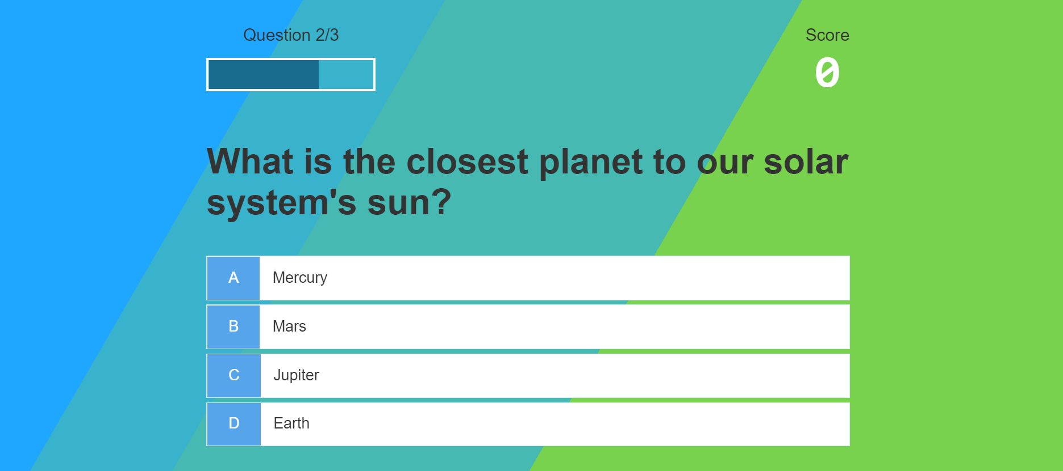
Website Glimpses
Game Page

Slide 6

Website Glimpses
Game End Page

Slide 7

Website Glimpses
High Scores Page

Slide 8
Thank You !

